Slide 1
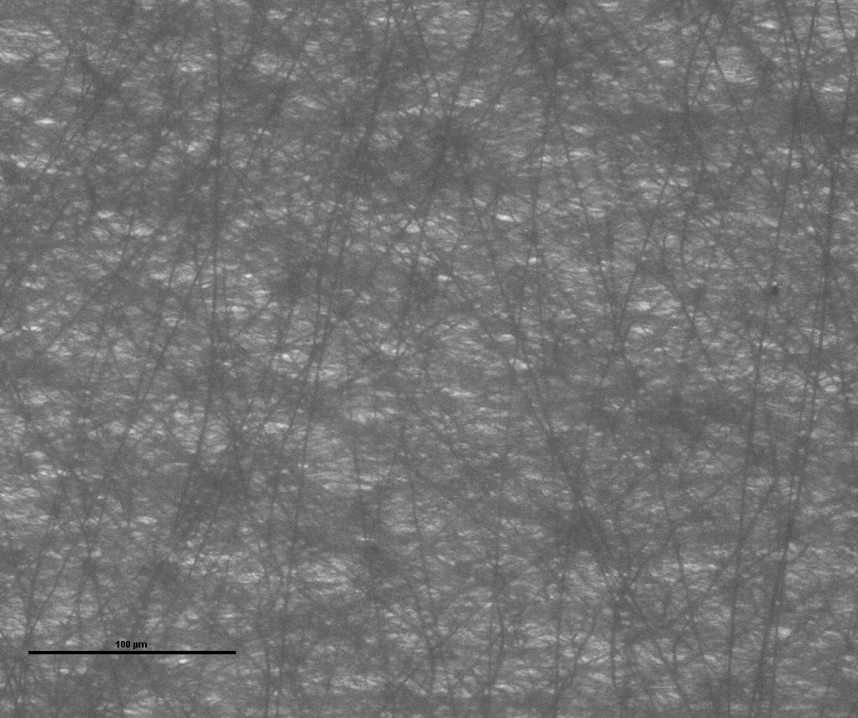
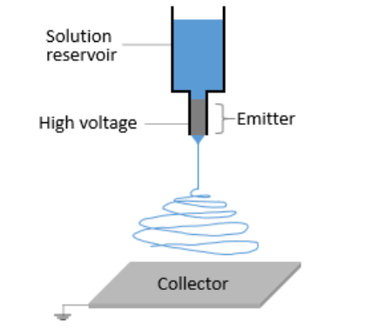
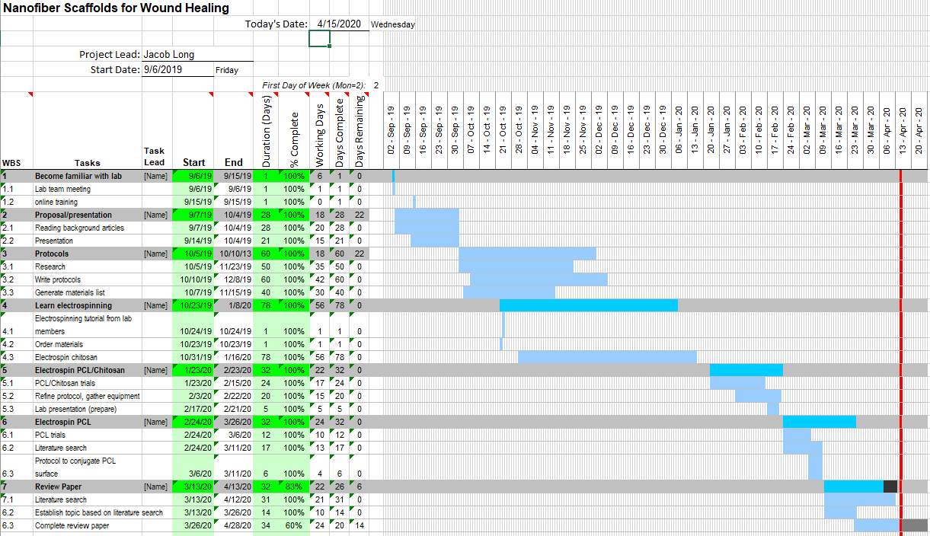
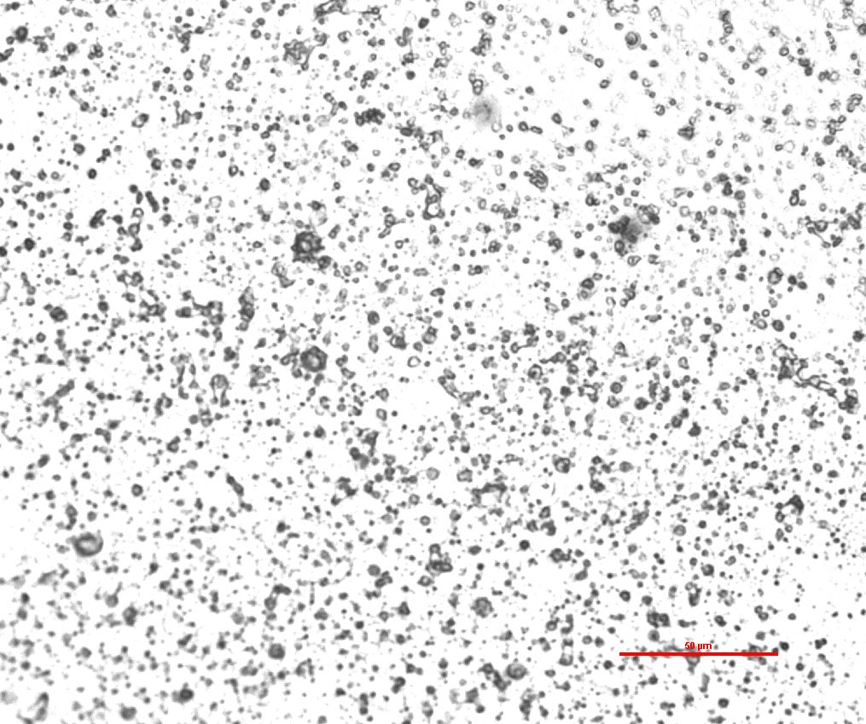
Problem:
Chronic wounds (see figure 1) affect more than 6.5 million people in the United States, and current treatment is only marginally effective. Tissue engineering presents opportunity through polymer scaffold construction to improve wound healing.
Tissue Engineering: Electrospinning Nanofiber Polymer Scaffolds for Dermal Wound Healing
Team 25 Jacob Long – Electrical Engineering
Avani Kabra – Medical Sciences (not CEAS) Advisor: Dr. Leyla Esfandiari Integrative Biosensing Laboratory, ERC 893
Goals:
- Learn how to electrospin nanofiber scaffolds from polymer solutions
- Understand applications of tissue engineering for dermal wound healing
- Learn how to search for and read scientific literature effectively
Figure 5: Electrospun PCL nanofibers 02/27/2020 (scale 100μm)
Figure 1: The first three stages of wound healing. Chronic wounds are typically arrested in the inflammation stage.
(Rieger, K. A., Birch, N. P., & Schiffman, J. D. (2013). Journal of Materials Chemistry B, 1(36), 4531.)
4. Review Paper on Cell-Surface Interactions and Extracellular Matrix Mimicking:
After the suspension of lab work our advisor suggested that we write a review paper relevant to our previous endeavors. This would develop our ability to read through scientific literature and give us a tangible goal for our project.
1. Electrospinning Chitosan
Learned about electrospinning, many trials with chitosan
Unsuccessful with low-risk acetic acid solvent (figure 3); replaced solvent with trifluoroacetic acid
Still unsuccessful (primarily due to insufficient literature search)
2. Electrospinning Chitosan/PCL
New plan after continued literature search: electrospin chitosan/polycaprolactone (chitosan/PCL) blend solution
Continued lack of success – after further reevaluation, advisor recommended that we further modify our protocol
3. Electrospinning PCL and surface modification
Successfully electrospun PCL scaffolds (figure 5)
Investigated biocompatibility of surface-modified PCL scaffolds
Very soon after, the university’s facilities closed indefinitely, suspending laboratory work
Solution:
Further improve polymer scaffolds for wound healing by electrospinning (figure 2) a scaffold from an optimal material, and adding additional substances to the scaffolds to facilitate cell proliferation and migration
What could be accomplished if the university were open?
Modify scaffold surface to improve properties
Compare fibroblast cell proliferation on modified and unmodified scaffolds
Publish paper outlining our experiment and findings
Figure 2: Typical electrospinning setup. A high voltage is applied to the solution at the emitter, which is projected to the collector as a “jet”. The solvent evaporates and the polymer is collected as a fiber.
Image source: Nanoscience.com
Figure 3: Attempt to electrospin Chitosan. Trial 12/10/2019 (scale 100μm)
Figure 4: GANTT Chart

